Slide 1
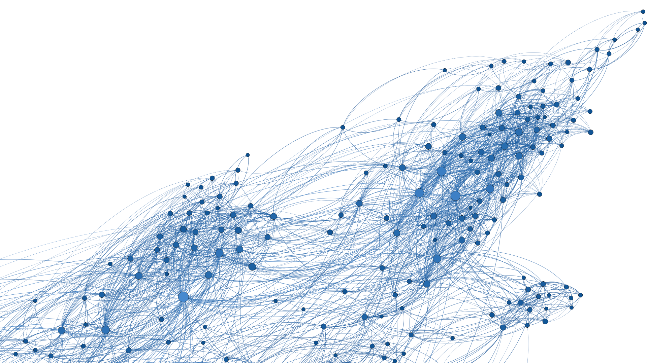
Information Spread in Corporate Social Networks
NETWORK ANALYSIS
Ida Ugilt Wennergaard
Julie Langeland Hagen
Sander Engel Thilo

Slide 2
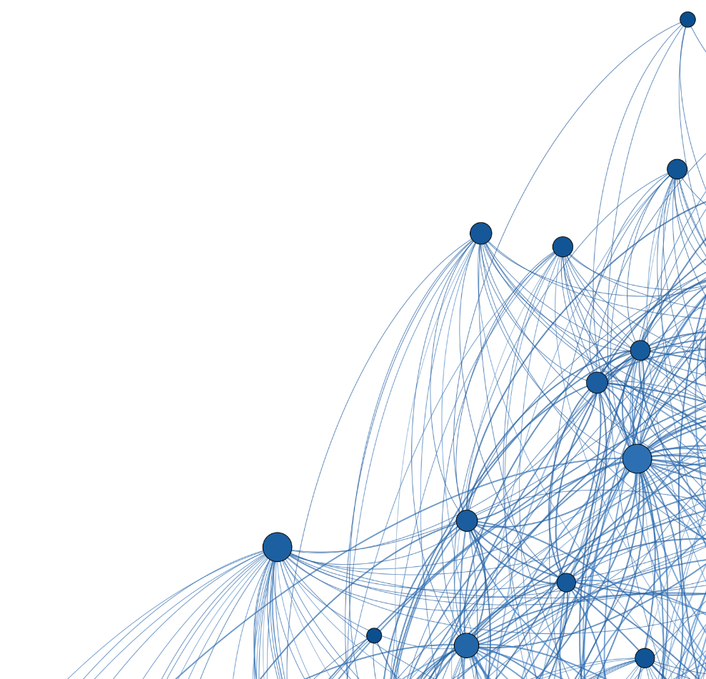
Our Network
facebook_organizations — Within-organization Facebook friendships (2013)
Fire, M., Puzis, R., Elovici, Y. Organization Mining Using Online Social Networks. 2013. Cornell University (via Netzschleuder). arXiv:1303.3741v2.
Description
One of six Facebook friendship networks among corporate employees
Chosen network refers to a medium telecommunication service company
1429 nodes
19357 edges
Notes:
Extra:
Six networks of friendships among users on Facebook who indicated employment at one of the target corporation. Companies range in size from small to large. Only edges between employees at the same company are included in a given snapshot.1

Slide 3
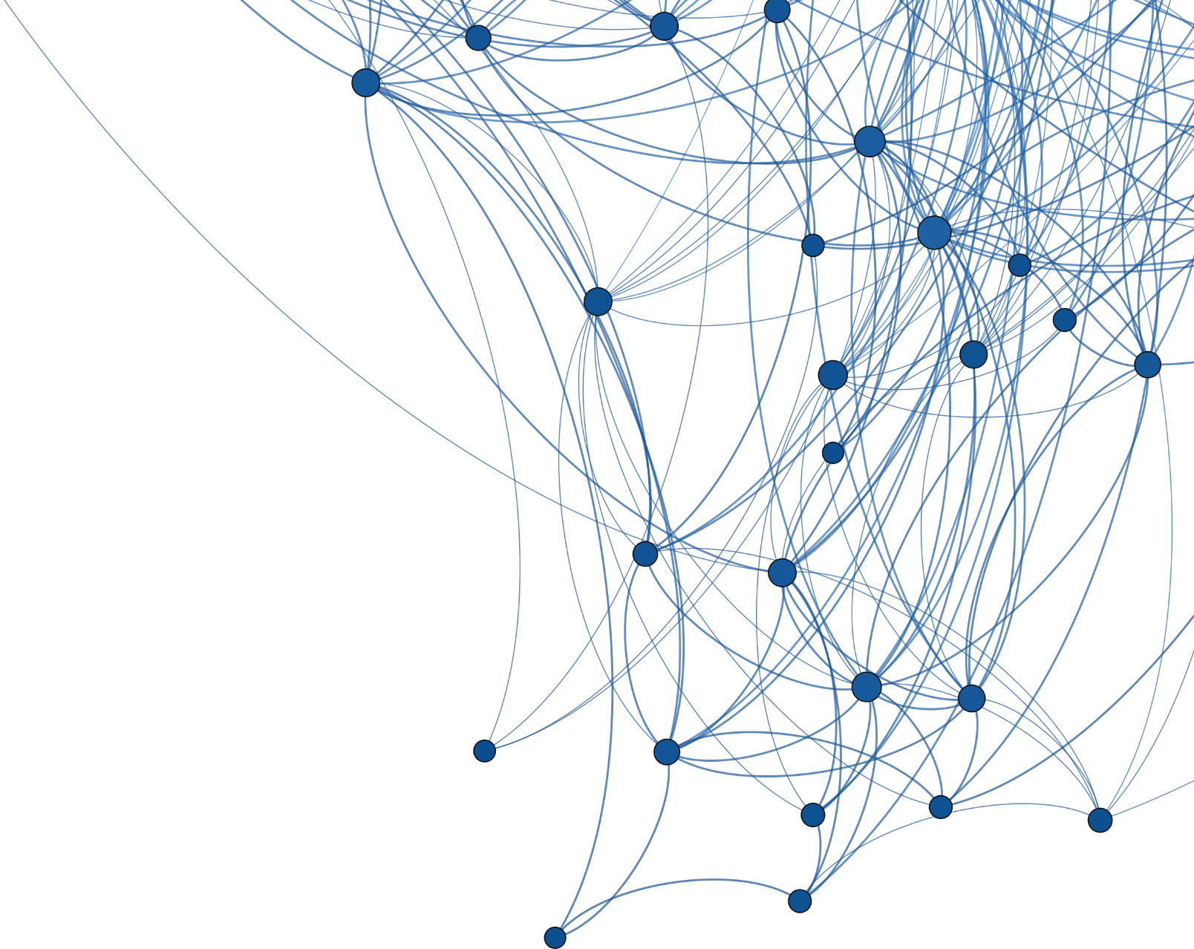
Motivation & Focus
Understanding Organizational Culture: Examining the spread of information within the organisation through SIR spreading models
Assessing Employee Behaviour: Using different reinforcement triggers to model how employees might react to hearing misinformation/rumours
Improving Influence and Managing Risk: Identifying the key starting employees which will lead to the fastest spread of information through the organisation, whether endorsed or not
Enhancing Resilience: Combating the spread of misinformation by implementing immunization strategies

Slide 4
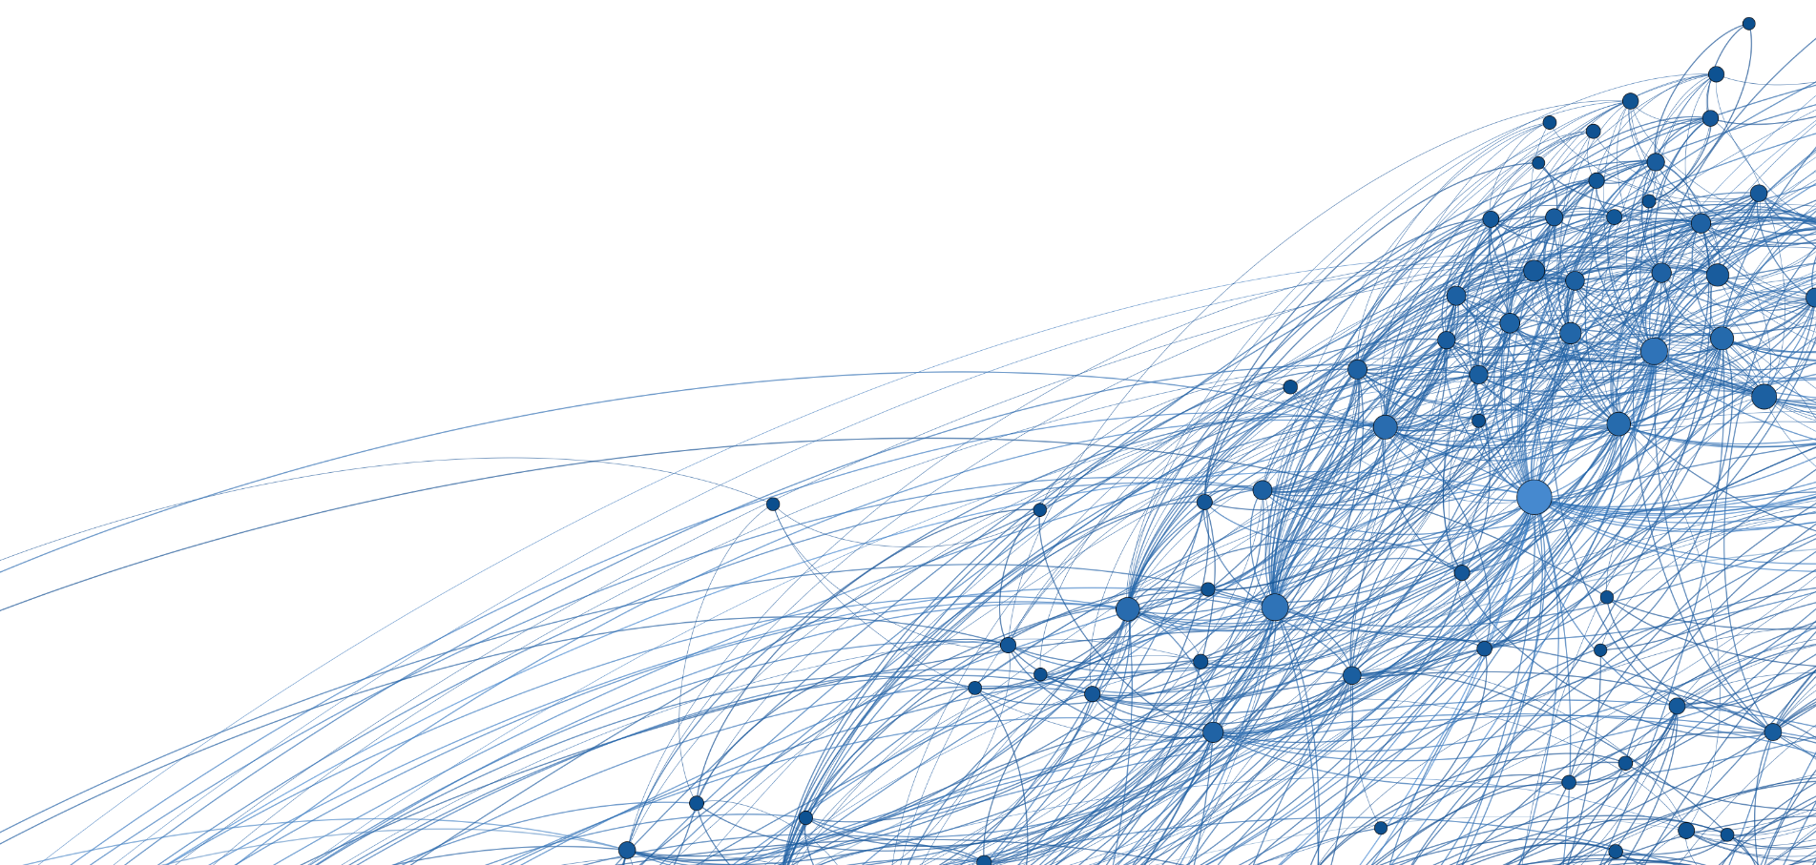
RESEARCH QUESTION
How does information spread in a social network under different assumptions?
How is the process affected if we remove key employees?

Slide 5
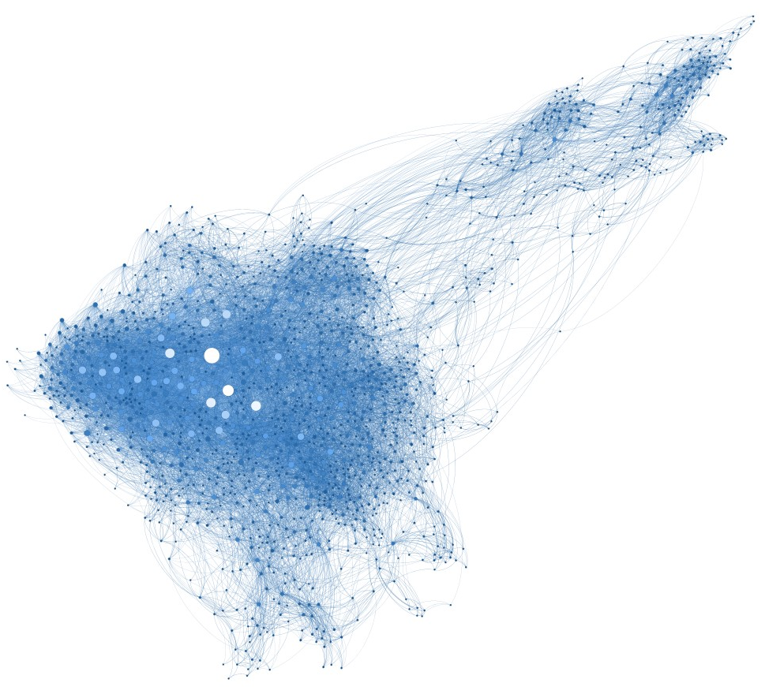
Exploratory Data Analysis
Average shortest path length : 3.04
Average degree: 27.09
Minimum degree: 2
Maximum degree: 339
Density: 0.019
Diameter: 7
Global clustering coefficient (transitivity): 0.2606
Notes:
Average Path Length: The sum of the lengths of all shortest paths in a network over the total number of such paths
Average shortest-path length is defined as the average number of steps along the shortest paths for all possible pairs of network nodes. It is a measure of the efficiency of information or mass transport on a network.
why is this important to know for us? shorter average path -> a faster spreading rumour, since it takes fewer steps for a rumour to spread from one person to another. can a rumour go viral in our network?
help us to see if there are some points in the network that we can target in order to slow down rumour spreading/ stop it completely
in our network the average path of 3 is relatively low-> rumour should spread quite fast
degree of a node: is the number of connections/edges it has to other nodes in the network). It's a measure of the node's connectivity within the graph.
Average degree: k ̄ = 2|E|/|V|. The average degree of a network is twice the number of edges divided by the number of nodes. Why twice? Because each edge increases by one the degree of the two nodes it connects (from the book).
what does it tell us? The average degree measures the average number of connections or friends each individual has in the network. Individuals with a higher degree have more friends, and they can potentially spread information to a larger audience.
average degree of 27 implies a relatively dense and interconnected network
Density: 0.019
Density is very low, however this is almost always the case for large real networks.
Diameter: The length of the longest shortest path in a network(book).
diameter of 7 is relatively low
This means that information or rumors can potentially spread quite efficiently because most individuals are relatively closely connected
Extra: Clustering coefficients standard deviation: 0.1921
Average clustering 0.4211
Random walk mixing time: 0.2992
Assortativity coefficient: 0.1123

Slide 6
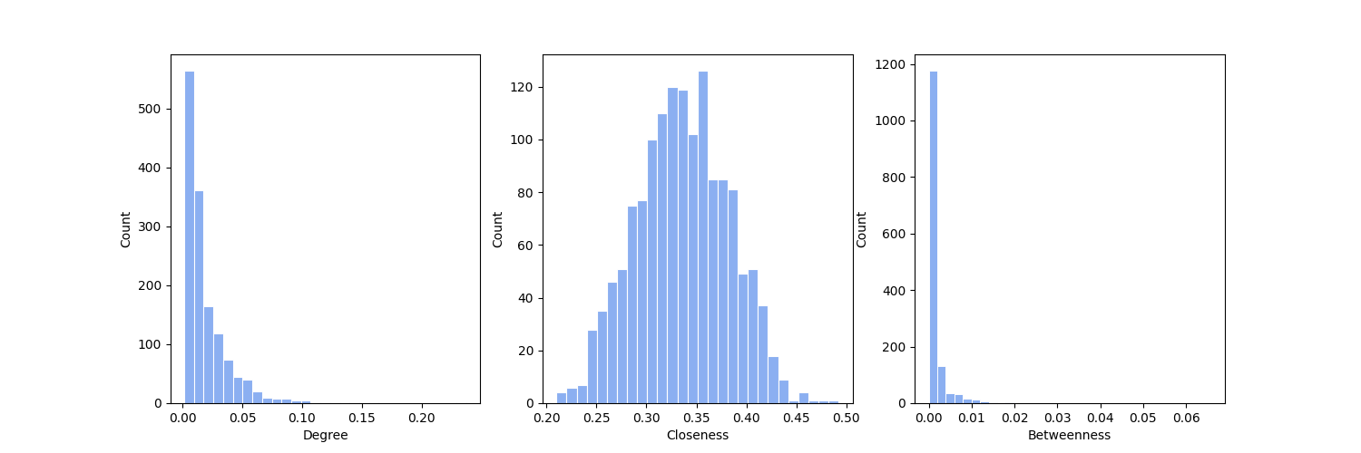
Centrality distributions
Node 17: max degree centrality, max closeness centrality, max betweenness centrality

Slide 7
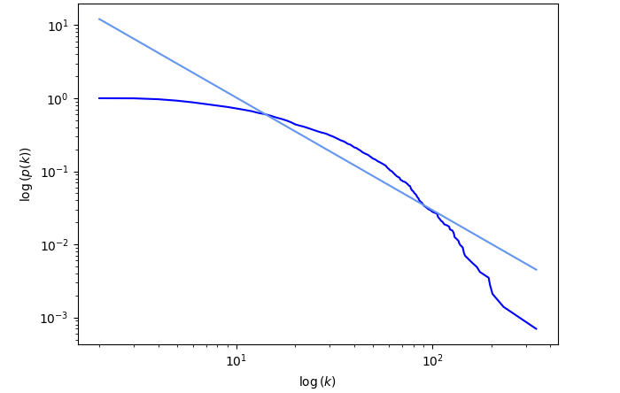
Powerlaw Fit
p(k) = k^{-α}
𝜶 = -1.5381
Notes:
Shifted powerlaw?
All people have a minimum of 2 friends

Slide 8
SIR Model Assumptions
S
I
R
Susceptible: May know the information but not willing to spread it
Infected: Knowing of the information and willing to spread it
Removed:
No longer interested in spreading the information
Notes:
limited infection chances modeled as SIR

Slide 9
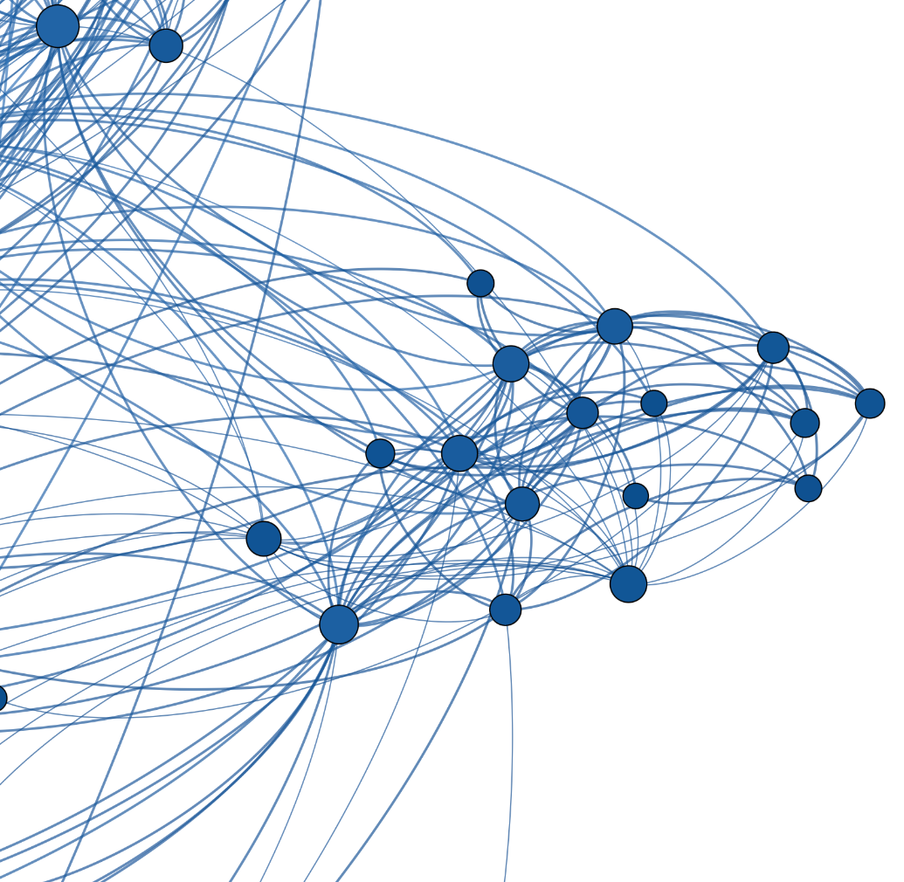
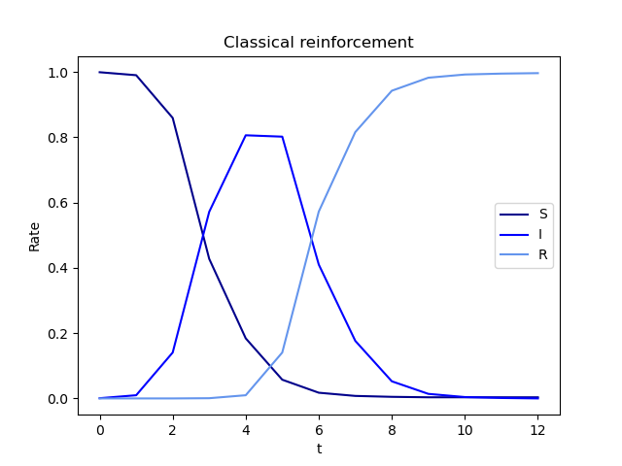
SIR Model Evolution
Trigger: Classical reinforcement
𝛽=0.3
ɣ=3

Slide 10
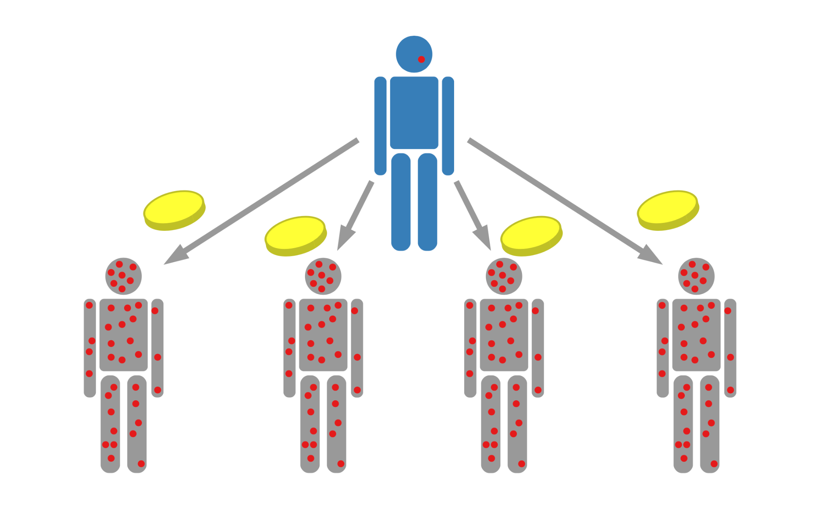
Classical Reinforcement

Slide 11
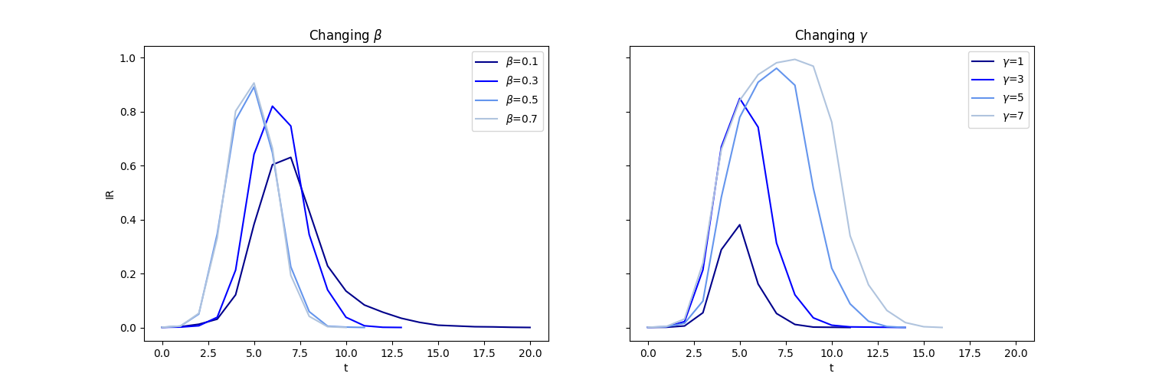
Classical Reinforcement
β: probability of infection for each infected neighbor
γ: time steps before transition to R

Slide 12
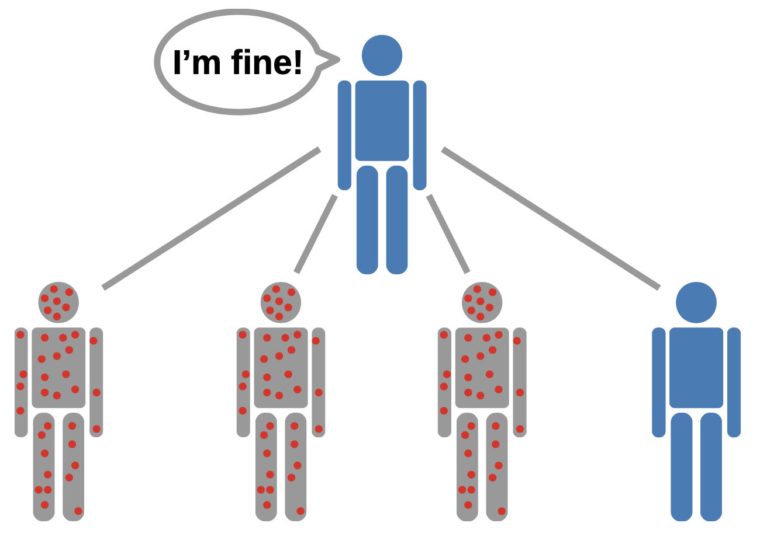
Threshold Reinforcement

Slide 13
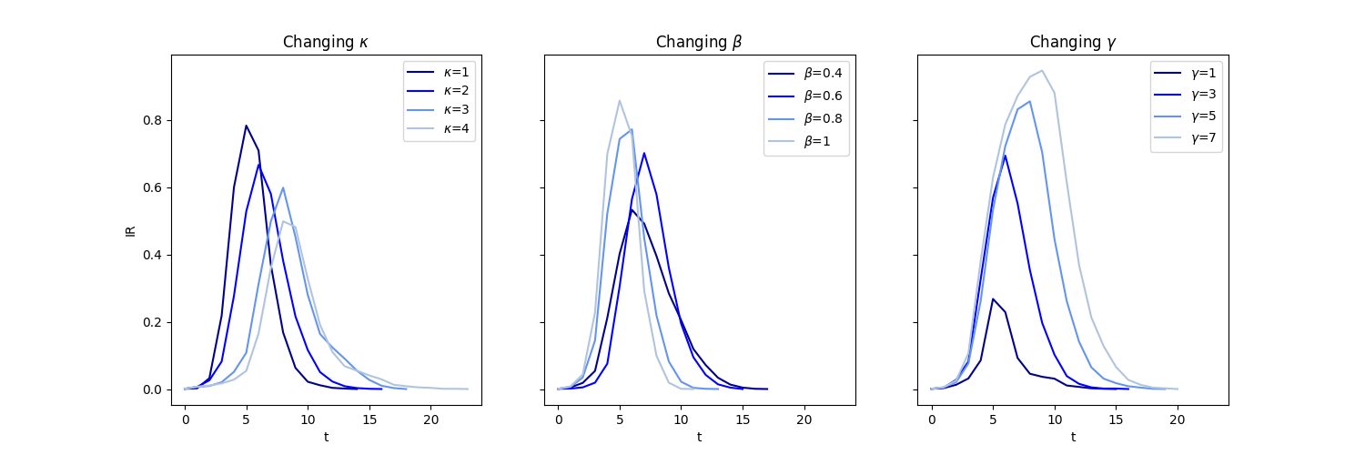
Threshold Reinforcement
κ: threshold
β: probability of infection when threshold is met
γ: time steps before transition to R

Slide 14
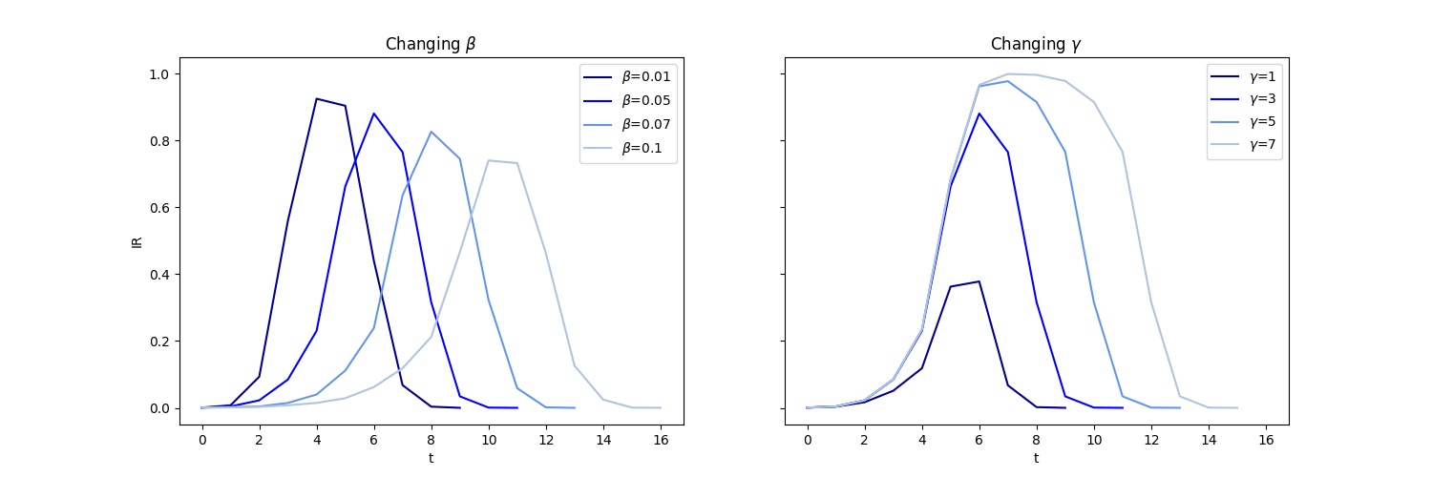
Cascade Reinforcement
β: fraction of infected neighbors needed to infect node
γ: time steps before transition to R

Slide 15
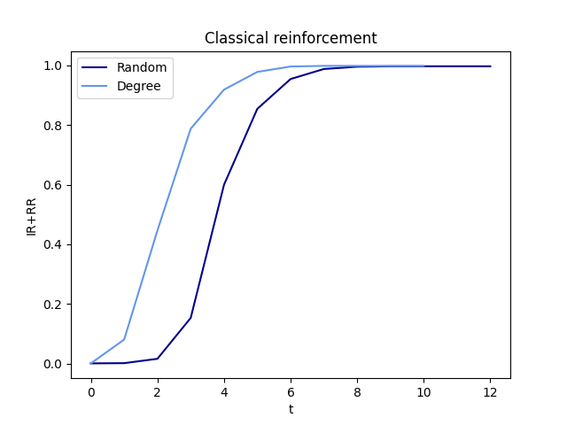
Targeting Single Key Employee

Slide 16
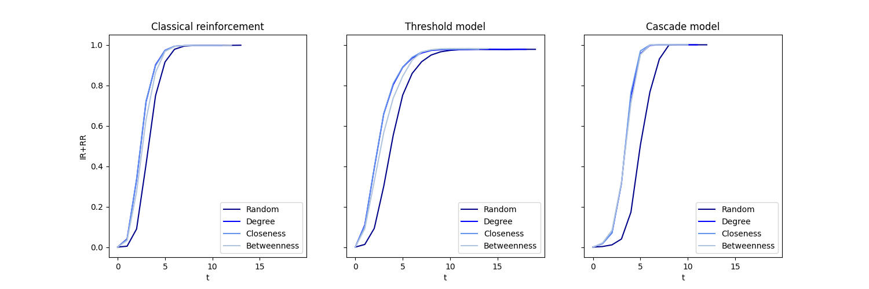
Targeting 10 Key Employees

Slide 17
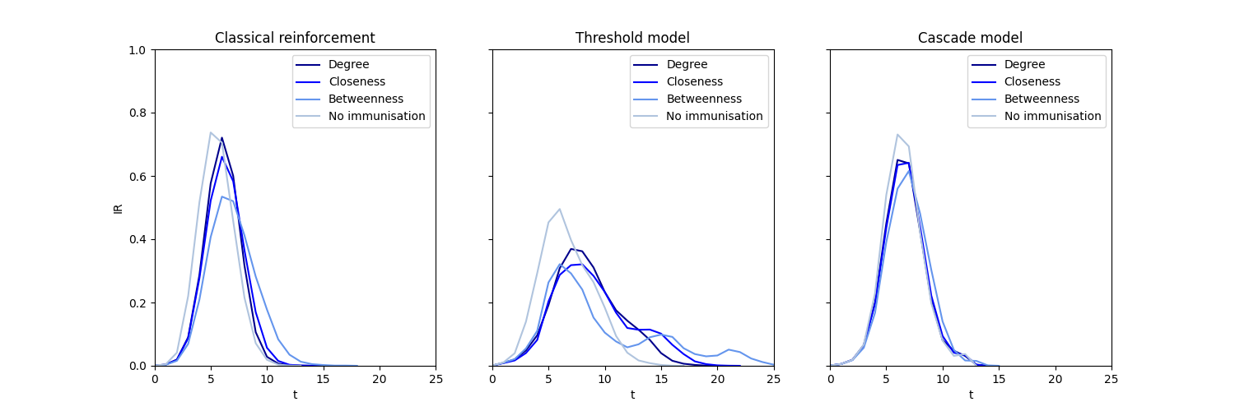
Immunization
Notes:
Removal of key employes
Effect on each model

Slide 18
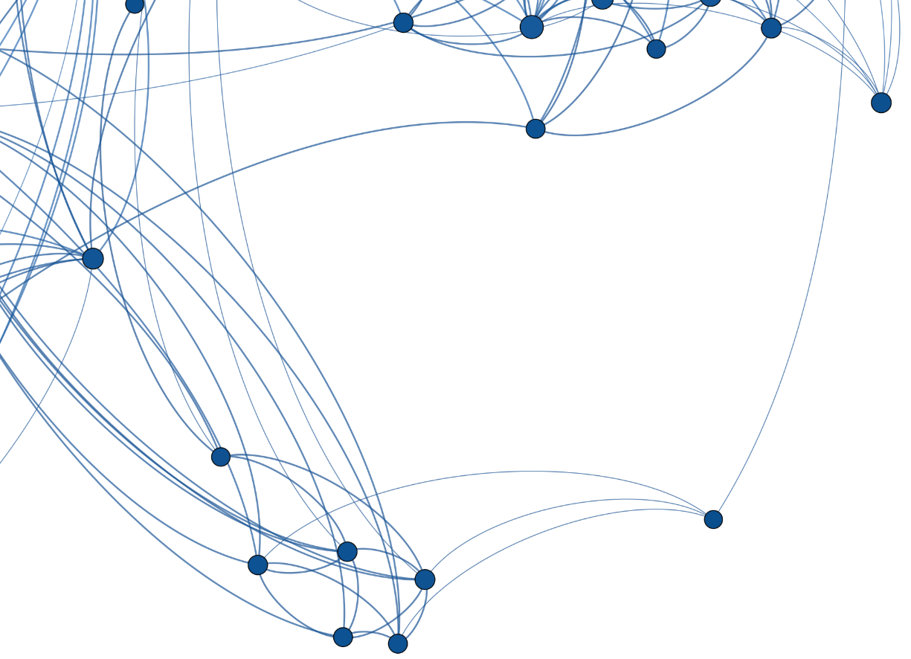
Limitations
Strong assumptions
Simulations vs. human behaviour
Missing employees
Notes:
human behaviour is very unpredictable

Slide 19
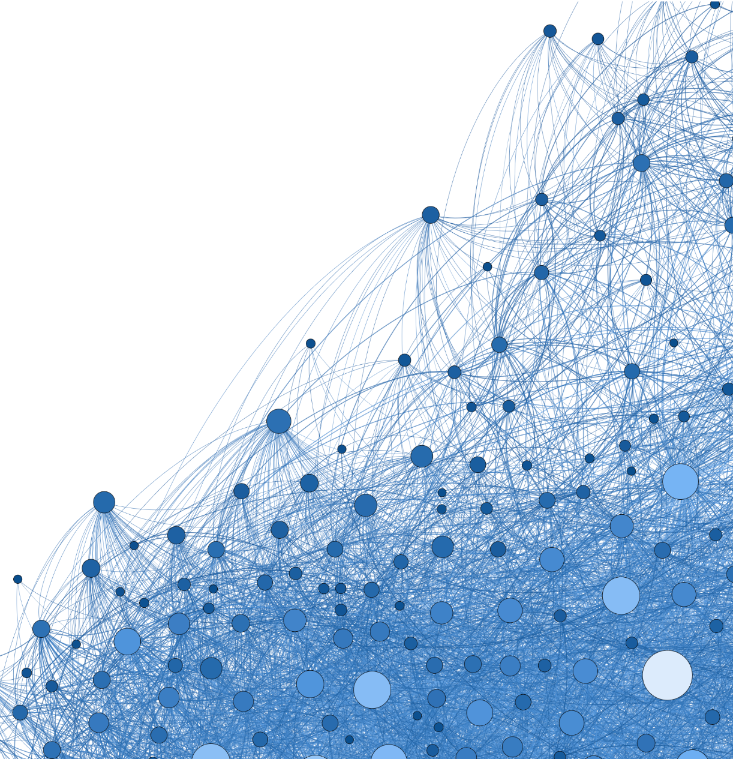
Conclusion
The underlying assumptions influence which employees that are considered as key employees.
Identifying key employees is important if you want to spread crucial information, or if you wish to limit the spread of ‘bad’ information.
Further Research:
Develop more advanced models that can accurately simulate real-life
Analyse Communities

